Slide 1


Introduction
Darren Atkinson is an Associate Professor in the Department of Computer Engineering at SCU
Professor Atkinson is acting as our client/customer
He has tasked us with improving the currently inefficient system Santa Clara University has for graduate students filling out their courses (Path of Studies)

Slide 2
Problems
There are several requirements on the form and no mechanism to enforce that these are correctly filled
These requirements include:
  The total number of units must be at least 45
  At least 8 credits must be from courses numbered 300 or greater
  Maximum transfer credit of 9 units from an outside institution or 16 units from SCU
  SCU Graduate core has at least 6 units and is non empty

Slide 3
Problems (cont.)
It is difficult to make changes because they are made in one of two ways
  Crossing out old fields or overwriting them (messy)
  Filling out a new form (more work)
    Both of these methods introduce errors
Some of the fields are not intuitive i.e. required core courses and may be improperly checked
Overall the current method is very error prone and inefficient

Slide 4
The customer requirements (functional)
To make a replacement graduate studies form that can be:
    Easily changed
    Printed
    Saved
    Web accessible
    Capable of basic error checking

Slide 5
The customer requirements (non-functional)
To make a replacement graduate studies form that:
  Has easily understood directions
  Is user friendly
  Is secure
  Is efficient
  Makes it easy to add additional forms

Slide 6
Solution
Excel spreadsheets
  Meets primary requirements of edit, print, and save
  Capable of implementing calculations and errors
  Widely supported
Web Page
  Provides access to excel files

Slide 7
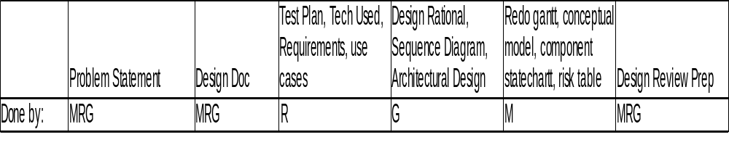
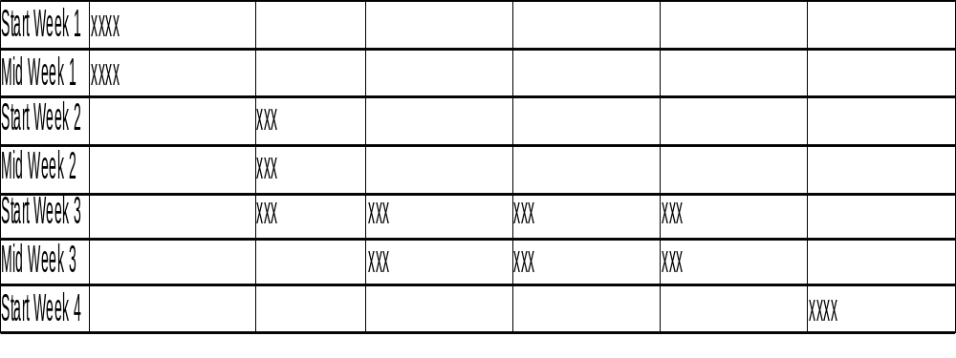
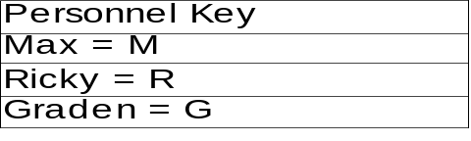
Timeline (part one)

Slide 8
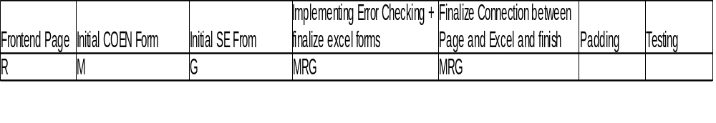
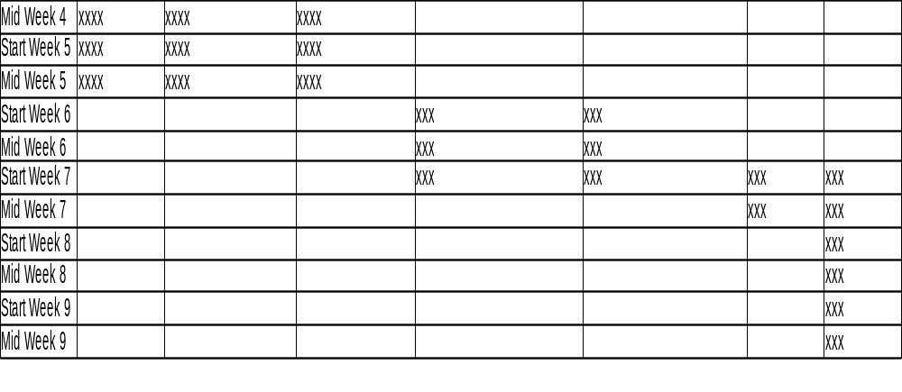
Timeline (part two)

Slide 9
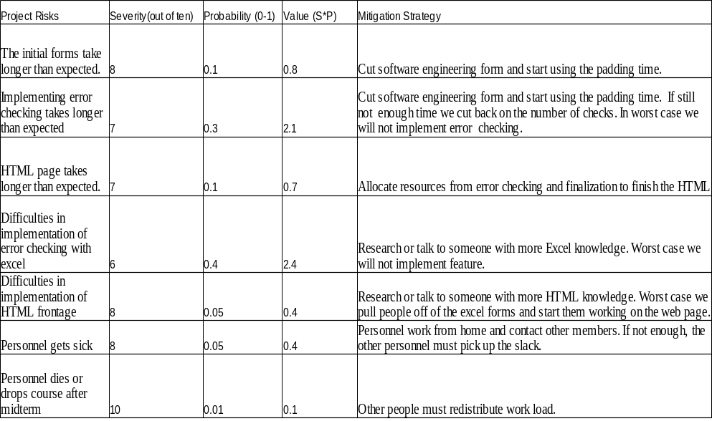
Project Risks

Slide 10
Use Cases
1.Student Prints Form
Actor: Student
Goals: Fill out and print new Program of Studies to take to advisor.
Preconditions : Student has open copy of filled out form.
Main Task: Student saves form to computer and prints the completed typed form to take to their advisor for approval.
Post Condition: Student has physical copy of form to take to advisor
2.Student Changes Saved Form
Actor: Student
Goals: Change current Program of Studies.
Preconditions : Student has saved previous version to computer.
Main Task: Student opens saved form and types out changes. Student re-saves form, and can print a copy for advisor.
Post Condition: Student has saved copy of altered form available for printing

Slide 11
Use Cases cont.
3.Student Downloads Copy of Viewer Software
Actor: Student
Goals: Acquire software capable of opening .xml form
Preconditions: Student has internet access
Main Tasks: 1 Student goes online and follows instructions on front-end webpage to select and download the appropriate viewer software.
Post Condition: Student now has software capable of opening and altering the .xml form.

Slide 12
Use Cases (cont.)
4.Student Fills Out Form
Actor: Student
Goals: Fill out Program of Studies to take to advisor.
Preconditions : Student has internet access, browser, and viewer software
Main Task:
1.Student goes online and follows instructions on web page to download .xml form.
2. Student uses viewer software to open form and types in identifying information.
3. Student types in transfer information, required courses, and other required information.
4. Form checks for accuracy and returns an error. Return to step 3.
5. Student saves form for use and approval.
Exceptions:
1. Form returns an error because student is attempting to transfer too many credits. Student must change information.
2. Form returns an error because student is not taking enough classes numbered 300 or up. Student must change information
3. Form returns an error because student is not taking enough overall credits. Student must change information. Student must change information.
4. Form returns an error because student did not correctly fill out Graduate Core Requirements. Student must change information.
Post Condition: Student has a correctly filled out form ready for printing and approval.

Slide 13
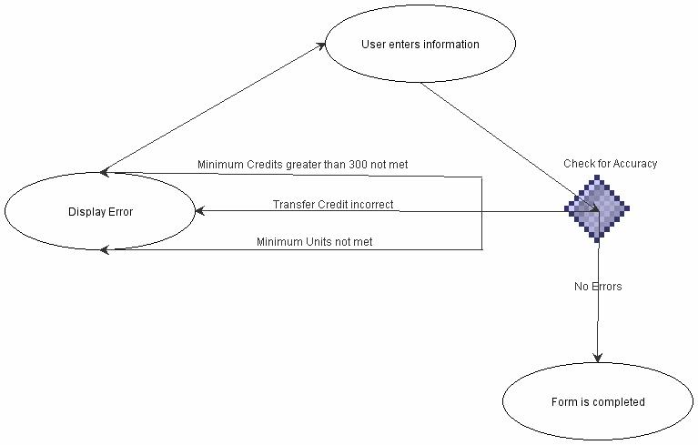
Activity Chart for use case 4

Slide 14
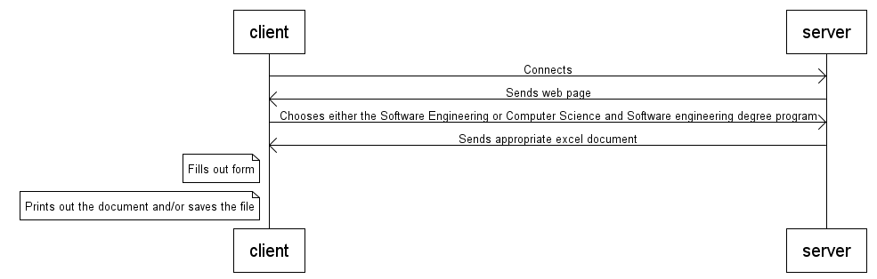
Sequence Diagrams
This shows interaction of the user with the system

Slide 15
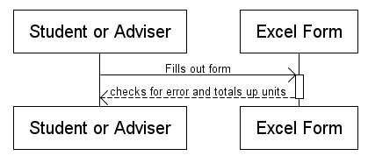
Sequence Diagram
Student or advisor filling out form

Slide 16
Solution Tech
.xls
  Microsoft Excel spreadsheet format
  Used and supported by all versions of Excel, OpenOffice, Google Docs, and others
  Viewing and editing software freely available on all platforms
  Supports automation of calculations and auto-fill
  Not directly web accessible WEB_BASED? BROWSER VIEWABLE?

Slide 17
Solution Tech cont.
HTML
  Default markup language for web pages
  Viewable in any browser
  Supports links to downloadable files

Slide 18
Excel Forms
Configured to look almost exactly like current Course of Study Forms
  Most cells locked to prevent tampering
Use calculation features to:
  Automatically calculate total units
  Return error
    if transfer credits over maximum
    if field is missed
    Etc. FIX

Slide 19
Web Page
Formatted to look like standard SCU web page
Includes instructions on how to fill out Excel forms
  Minimizes user error and confusion
Also provides links to free Excel editing software
  OpenOffice, Google toolbar/Docs

Slide 20
Advantages
Easy to implement
  Both easy to create and easy to deploy
  Can be added to existing website structure either by replacing current Course of Studies page or by adding links from other pages
Easy to maintain
  Individual forms are independent of web page and each other
  Simple non-interactive web page require little maintenance

Slide 21
Advantages cont.
Easy to expand
  New forms can be added with a simple link
  Web page format can be duplicated with small changes for other departments
Familiar
  Most users have encountered excel
  Form extremely similar to current form, no changes required

Slide 22
Disadvantages
Many steps
  User possibly has to download and install software
  User has to download and save form to computer, open it in software, edit, save, then print.
    Require two different software components (browser and editor)
Polish
  Excel form not as polished or professional as more advanced methods of interactive forms

